Slide 1
History Diploma introduction

Slide 2
Overarching Themes
Second World War

Slide 3
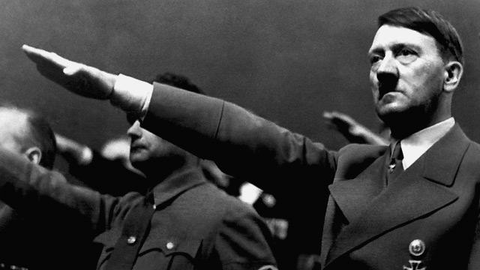
Overarching Themes
Single Party State
Leaders

Slide 6
Overarching Themes
China

Slide 7
Higher or Standard?
Intellectual level is the same for HL and SL
HL and SL do the same Papers 1 and 2
HL does an additional Paper 3
Internal Assessment weighted more for SL

Slide 8
What skills do I need to have to be successful?
Interest in the past
Writing skills
Enjoyment of reading
Discussion and debate

Slide 9
How will History help me gain skills for the future?
Communication
Problem solving
Collaboration
Evaluating information
Understanding of the current world situation

Slide 10
How will History help me in my career?
Law
Politics
Accountancy
Journalism
Research
Business
Forensics

