Slide 1
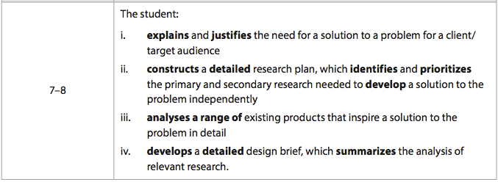
Criteria A -Inquiring and analysing

Slide 2
Explain and Justify
You need to explain and justify the need for a solution to the problem you have identified for the target audience/client.
Use your research to help you do this. Think - Who, why, how, where, what.
By the end of this you should identify 6-10 research topics/questions

Slide 3
Identify research required
What research can you do? List - this should be the research topics/questions you identified in your explain and justify section
What research will you carry out in order to make a successful product?
What is the most important information for your product to be successful? Rank in order of importance.

Slide 4
Research table
Priority | Research question | Why is it important? | Primary or secondary | What did you learn?
1
2
3
etc.

Slide 5
Research
You now need to carry out research to find a solution to the problem you have identified.
It can be physical testing (materials, product, gears, levers, pulleys, systems etc), internet based (not wikipedia and referenced), books, photographes etc.

Slide 6
Analyse existing products
Are there products that already exist for your problem? Can they be improved?
If not, are there similar products?
Select a range of existing/similar products and analyse them carefully. Look at the positive and negative aspects of the product and remember ACCESSFM.

Slide 7
Brief
What will you design and make, who for, what must it do, why, how, where etc?
ACCESSFM could help you.
This section should be 1-2 pages.

