Slide 1
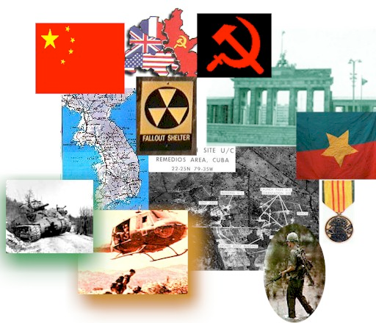
THE Cold War

Slide 2
What was the cold war ?
The Cold War is the name given to the relationship that developed primarily between the USA and the USSR after World War Two. The Cold War was to dominate international affairs for decades and many major crises occurred - the Cuban Missile Crisis, War in Korea,Vietnam, Hungary and the Berlin Wall being just some. For many the growth in weapons of mass destruction was the most worrying issue.

Slide 3
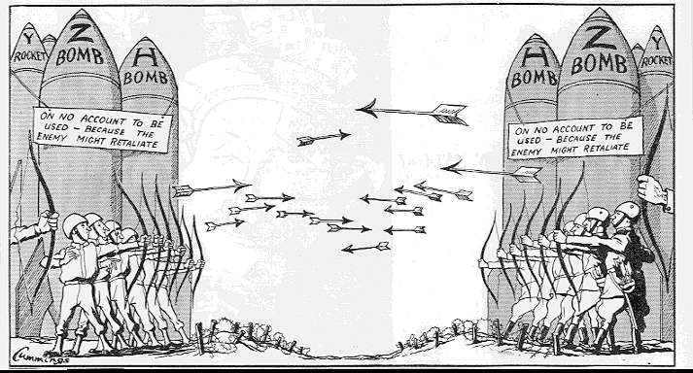
The Cold War-what was it all about ?

Slide 4
Why did the ‘Cold War’ begin ?
Why did it last for so long ?
We have already established that the two countries did not trust each other
Both countries also wanted to be powerful and in fact they both became ‘superpowers’
Both countries tried to influence other countries in different ways
Both countries involved themselves in different conflicts throughout the world eg. Korea, China, Vietnam
Both countries had different ideologies

Slide 5
What is ideology ?
An ideology can be thought of as a comprehensive vision, as a way of looking at things or a set of ideas proposed to all members of a society.
A Political Ideology is a certain ethical set of ideals, principles or doctrines that explains how society should work.
It also concerns itself with how to allocate power
It usually contains certain ideas on what it considers to be the best form of government (e.g. democracy), and the best economic system (e.g. capitalism, socialism, etc)
THE USA AND THE USSR: One of the greatest differences between the USA and the USSR was that they had different ideologies. The focus of their differences was ‘capitalism’ vs ‘communism’. What did this really mean ?

Slide 7
competition, equality, choice, individual interest, community interest, government regulation
Task 1: For each of capitalism and communism create a graph that ranks the characteristics above on a scale from low to high
Task 2: Working with a partner, write a paragraph that uses all of the words in the title of this slide to explain the differences between capitalism and communism
Research: Find out what countries have at some time in history been considered to be communist. Make a list of as many as possible (give the years).

