Slide 1
What is OPVL?
A method to evaluate sources

Slide 2
Origin
What is it?
When was it produced?
Where does it come from?
Who produced it?

Slide 3
Purpose
Why was it produced?
think about who the intended audience was..
think about the aim of the creator…

Slide 4
Value
What is the value of the source to an Historian?
This is derived from the Origin & Purpose

Slide 5
Limitations
The problems or difficulties associated with the source. Comes from the Origin & Purpose.
lacks detail
over-simplified
important parts missing
includes bias
may have been changed or altered in some way

Slide 6
Summary
What
When
Value
Origin
Where
Limitations
Who
Why
Purpose

Slide 7
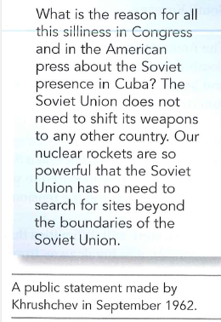
Have a Go!

Slide 8
Taking OPVL to a new level… OPCVL
If you are confident with OPVL, try your hand at OPCVL (origin, purpose, content, value and limitation)
Evaluate the source using the origin, purpose and content

