Slide 1
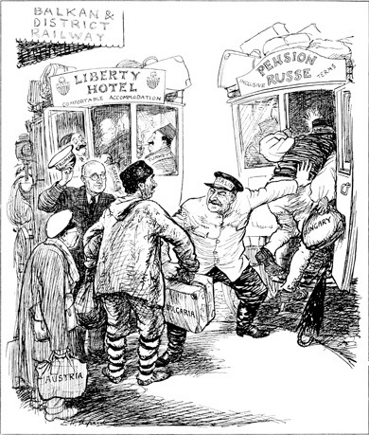
This cartoon of 18 June 1947 was drawn by EH Shepard for the British satirical magazine Punch.
The Rival Buses

Slide 2
What is the message of this cartoon?

Slide 3
Context – what was happening at the time?
Content – what is happening in the cartoon?
Comment – what is the message of the cartoon?

Slide 4
Context – what was happening at the time?
International relations were strained following the end of the Second World War.
The US & USSR were both seeking allies and larger spheres of influence in the new world order.
They were also offering to help other countries to recover after the war.

Slide 5
Two rival bus drivers are looking for passengers
They are in the Balkans, and there are potential passengers from several central & eastern European countries.
Hungary is being pushed whilst Bulgaria is being grabbed.
Content – what is happening in the cartoon?

Slide 6
One of the drivers politely raises his cap.
One bus is headed towards the Liberty Hotel offering ‘comfortable accommodation’, the other is destined for Pension Russe which has ‘inclusive terms’
Passengers seem tired and confused.
Content – what is happening in the cartoon?

Slide 7
The future of Eastern Europe is up for grabs. The US & USSR are competing for control and influence.
Hungary & Bulgaria have been bullied into joining with the Soviets.
Austria could be next.
Comment – what is the message of the cartoon?

Slide 8
The USA is offering freedom and prosperity, whilst the USSR seems more concerned with power and controlling the countries of eastern & central Europe.
Comment – what is the message of the cartoon?

Slide 9
OPVL
What? - A cartoon in a satirical British magazine.
When? - 18th June 1947; the time when Truman was inviting European countries to ask for aid via the Marshall Plan.
Where? - The UK (a strong ally of the US).
Who? - British cartoonist, Ernest Shepard.
Why? - To persuade the undecided European countries that the US offered them a more attractive future than the Soviets, and to suggest the beginning of a ‘containment’ policy.

Slide 10
Origin | Purpose | Value | Limitations

