Slide 1
What is the purpose of school?

Slide 2
Most Likely to Succeed. [Picture]. Retrieved from http://amppob.com/most-likely-to-succeed
Notes:
Industrial Model

Slide 3
Top 10 In-Demand Skills
Complex Problem-Solving
Critical Thinking
Creativity
Emotional Intelligence
Management
Cognitive Flexibility
Negotiation
Service Orientation
Coordinating with Others
Judgement
Source: Future of Jobs Report. World Economic Forum, 2016
Notes:
Why does it matter if our organizaions support agile teaching and learning? Published in WSJ, Research from Third Way –US based think-tank.
Title says it all: Is-your-job-routine-if-so-its-probably-disappearing!
What’s taking their place?

Slide 4
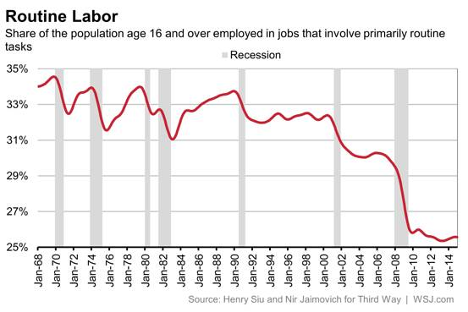
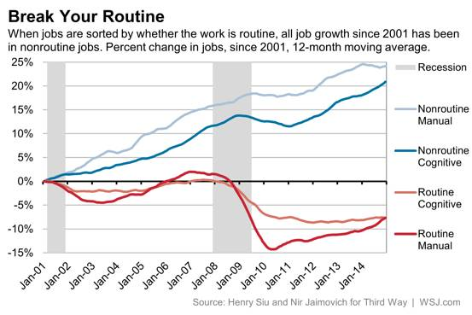
Source: “Is Your Job ‘Routine’? If So, It’s Probably Disappearing.”
Notes:
Title says it all: Is-your-job-routine-if-so-its-probably-disappearing!
What’s taking their place?

Slide 5
Source: “Is Your Job ‘Routine’? If So, It’s Probably Disappearing.”
Notes:
Why does it matter if our organizaions support agile teaching and learning? Published in WSJ, Research from Third Way –US based think-tank.
Title says it all: Is-your-job-routine-if-so-its-probably-disappearing!
What’s taking their place?

Slide 6
Credit: Martin Ruthivilaivan, Shekou International School 2016

Slide 7
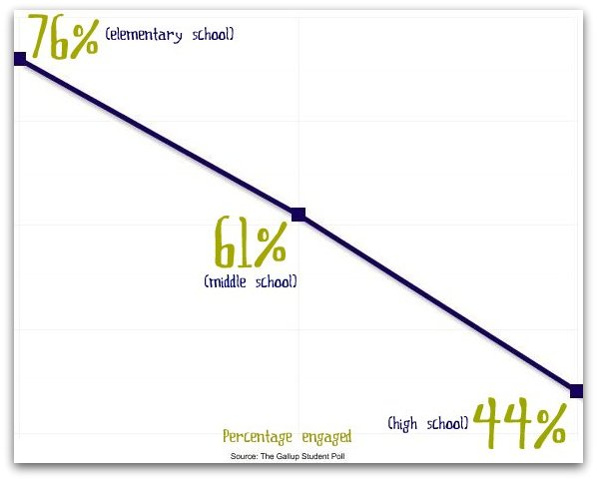
“The School Cliff”
Source: The Gallup Student Poll
The School Cliff. [Picture]. Retrieved from http://educationinhudson.com/student engagement
Notes:
Why does it matter if our organizaions support agile teaching and learning? Published in WSJ, Research from Third Way –US based think-tank.
Title says it all: Is-your-job-routine-if-so-its-probably-disappearing!
What’s taking their place?

Slide 8
Drive. [Picture]. See Daniel Pink’s TED Talk here
Notes:
Why does it matter if our organizaions support agile teaching and learning? Published in WSJ, Research from Third Way –US based think-tank.
Title says it all: Is-your-job-routine-if-so-its-probably-disappearing!
What’s taking their place?

Slide 9
MOTIVATION!
AUTONOMY
MASTERY
PURPOSE
See Daniel Pink’s TED Talk here

Slide 10
What is the purpose of (our) school?

Slide 12
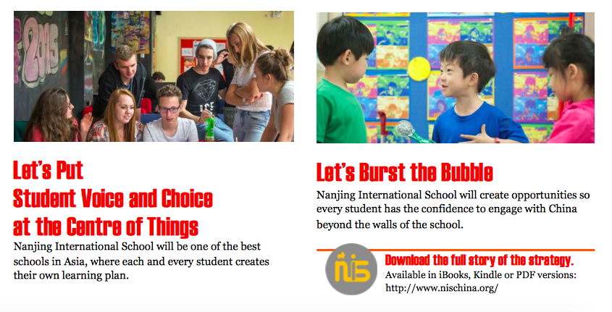
Learn more at nischina.org

Slide 13
How might we... create structures to support the kinds of learning we’d like to see more of at NIS?

Slide 14
Grade 6/7 Student-led inquiry Block
Mission
Strategy
Research/
Prototypes
IB MYP
Notes:
Alignment

Slide 15
Grades 6 /7 SY 17-18
Block Three, Every School Day (“Center of things!”)
Incubator for Student V/C & Bursting the Bubble
Groups of 10-12 Grade 6/7 students assigned to Advisors
Two Blocks of Advisory, One Block of Life 101 (Kris B.)
5 Blocks: Sustained, structured interdisciplinary inquiry!
Frequent community sharing events!

Slide 16
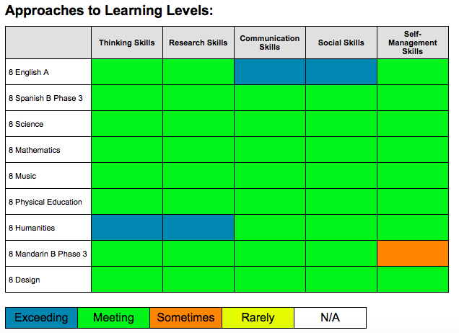
What’s the structure?

Slide 17
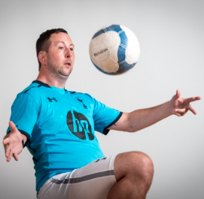
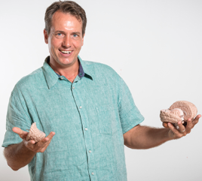
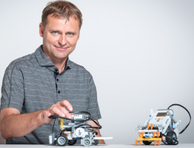
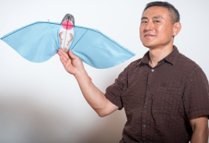
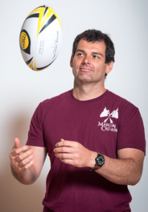
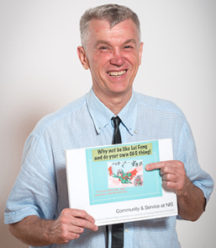
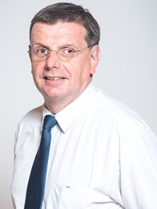
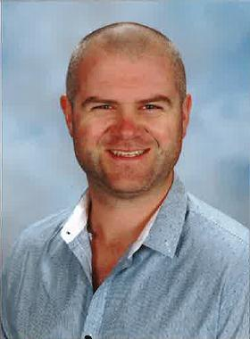
Who?
Nick Baker

Slide 18
What about other classes?
Subject Area | Classes per cycle | Classes per year | % of IB Requirement
English A/B | 4 | 88 | 176%
Mandarin A/B or German A | 4 | 88 | 176%
French/Spanish B or ECSS Or Korean A | 4 | 88 | 176%
Science | 4 | 88 | 176%
Maths | 4 | 88 | 176%
Humanties | 3 | 66 | 132%
Art, Drama, and Music | 3 | 66 | 132%
Design | 3 | 66 | 132%
Physical Education | 3 | 66 | 132%

Slide 19
Are we alone in this?

Slide 20
What will we call it?
Sparks
STORM
ROARS
AMPed
Mynovate
iLab
Block3
REAL
Flyers
Connects
CNU
NISRevolution
Blockx
The Hub
NISCover
STRIVE
Jaiyou!
CogNISe
SV&C
NISEvolution
SLI

Slide 21
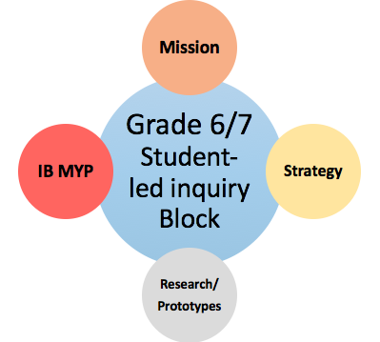
Next Steps…
Communicate
Refine
Connect
Launch!
Scale?

Slide 22
Learn more at nischina.org

