Slide 1
Contribution
Money received by the business that contributes to paying the fixed costs

Slide 2
Contribution
Contribution per unit = Unit price - AVC.
It is an amount that ‘contributes’ towards paying the fixed costs.
Profit = Total contribution -TFC.

Slide 3
Example
300 Widgets are sold for a price of $40 each.
Unit variable costs are $30.
Contribution per unit = $40-$30 = $10.
If TFC = $1400,
Profit = (300 x $10) - $1400
Profit = $1600

Slide 4
Contribution
At first the contribution per unit goes towards or ‘contributes’ towards paying the fixed costs.
Once the fixed costs have been met, all future contribution per unit goes to create profit for the business.

Slide 5
Total contribution
Total contribution = TR-TVC
eg a firm sells 200 clocks for $10 each. Total variable costs = $1300
Total contribution = (200 x $10) - $1300
Total contribution = $700
This $700 would go towards paying the fixed costs. If fixed costs = $600, then the business would make a profit of $100.

Slide 6
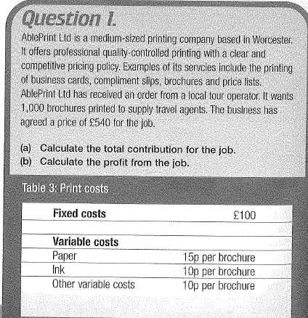
Question

Slide 7
Question
Hadley Ltd sells 350 widdles for $4.5 each. The business has fixed costs of $500. The variable costs per unit amount to $2.
1. Calculate the contribution per unit.
2. Calculate total contribution.
3. Calculate total profit.

Slide 8
Answer
1. $4.5 - $2 = $2.5
2. $2.5 x 350 = $875
3. Total cont. - TFC: $875 - 500 = $375
or, TR -TC: ($4.5 x 350) - (350x2 + $500)
$1575-1200 = $375

Slide 9
Uses of Contribution Analysis
Portfolio management - used by businesses selling several products.
Contributions per unit are compared.
Products with the lowest contributions will be reviewed to see if the firm should continue selling them.

Slide 10
Uses of Contribution Analysis
Helps decide prices (ie firms may want to know the price at which the product starts making a contribution to the fixed costs).
Allocation of overheads can be made using results of contribution analysis.

Slide 11
Uses of Contribution Analysis
Special orders. A one-off order at a lower price may be allowed if the new price still makes a contribution to overheads.
Calculation of break-even points.

Slide 12
Example
Jongde Ltd makes chairs. It usually sells them for $45 each. It sells 500 at that price. Unit variable costs are $30. Total fixed costs are$5750.
A customer places an order for 100 chairs. They demand a discount of $10 per chair due to the large order.
a)Should the firm accept the order?
b) What would happen if Jongde sold all their chairs for the discount price?

Slide 13
Contribution Analysis
Note, contribution per unit should never be used in isolation. Other factors need to be considered too eg:
unit sales volumes
relative market growth of different product lines

