Slide 1
Forced migration & internal displacement

Slide 2
What is migration?
When people move to live and work in a new place.
Can be international or within a country (internal).

Slide 3
Forced Migrations
When people don’t really want to move, but they have to.
Causes
to escape war, political or religious/ethnic persecution, or the break-down in law and order.
To escape famine or natural/human induced disasters.
The result of a government project (eg construction of a dam).

Slide 5
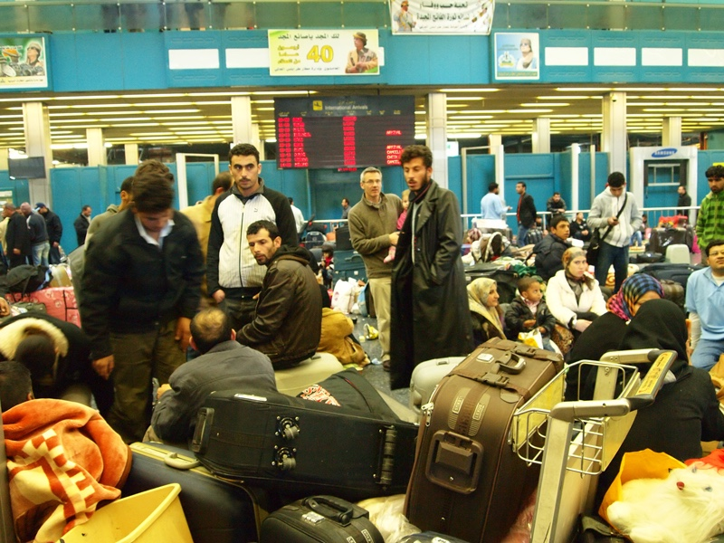

Slide 6
Classifying forced migrants
Refugees – People given the right to live in another country because they cannot return.
Asylum seekers – People seeking to be recognised as refugees in other countries.
Internally displaced persons (IDPs) – People who have been forced to move to another part of their own country.
Human trafficking – People coerced or deceived into moving. Essentially a modern-day form of slavery.

Slide 7
Examples to investigate
Tohoku earthquake, tsunami & nuclear accident – 2011 http://cgge.aag.org/Migration1e/CaseStudy6_Japan_Feb13/CaseStudy6_Japan_Feb13.html
Syria – 2010 - present day (See PDF)
Iraq - IDPs http://www.unhcr.org/internally-displaced-people.html
Niger (See PDF)
Hurricane Katrina 2005 https://blog.education.nationalgeographic.com/2015/08/27/mapping-migration-after-hurricane-katrina/
China – Three Gorges Dam (1.3 million people displaced) http://www.bbc.com/news/world-asia-china-17754256

