Slide 1
Land & food resources

Slide 2
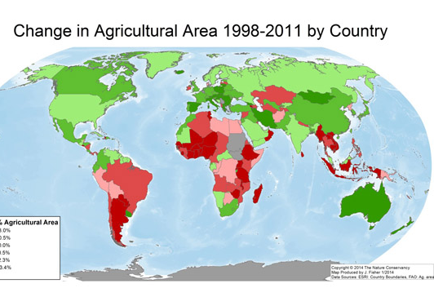
Recent changes
Globally, more land is being used to grow food and more food is being grown.
Farming land in LICs is increasing due to rising populations
Farming land in HICs is decreasing (eg the EU) due to; increased yields through technology gains, stable/declining populations & increased food imports.

Slide 3
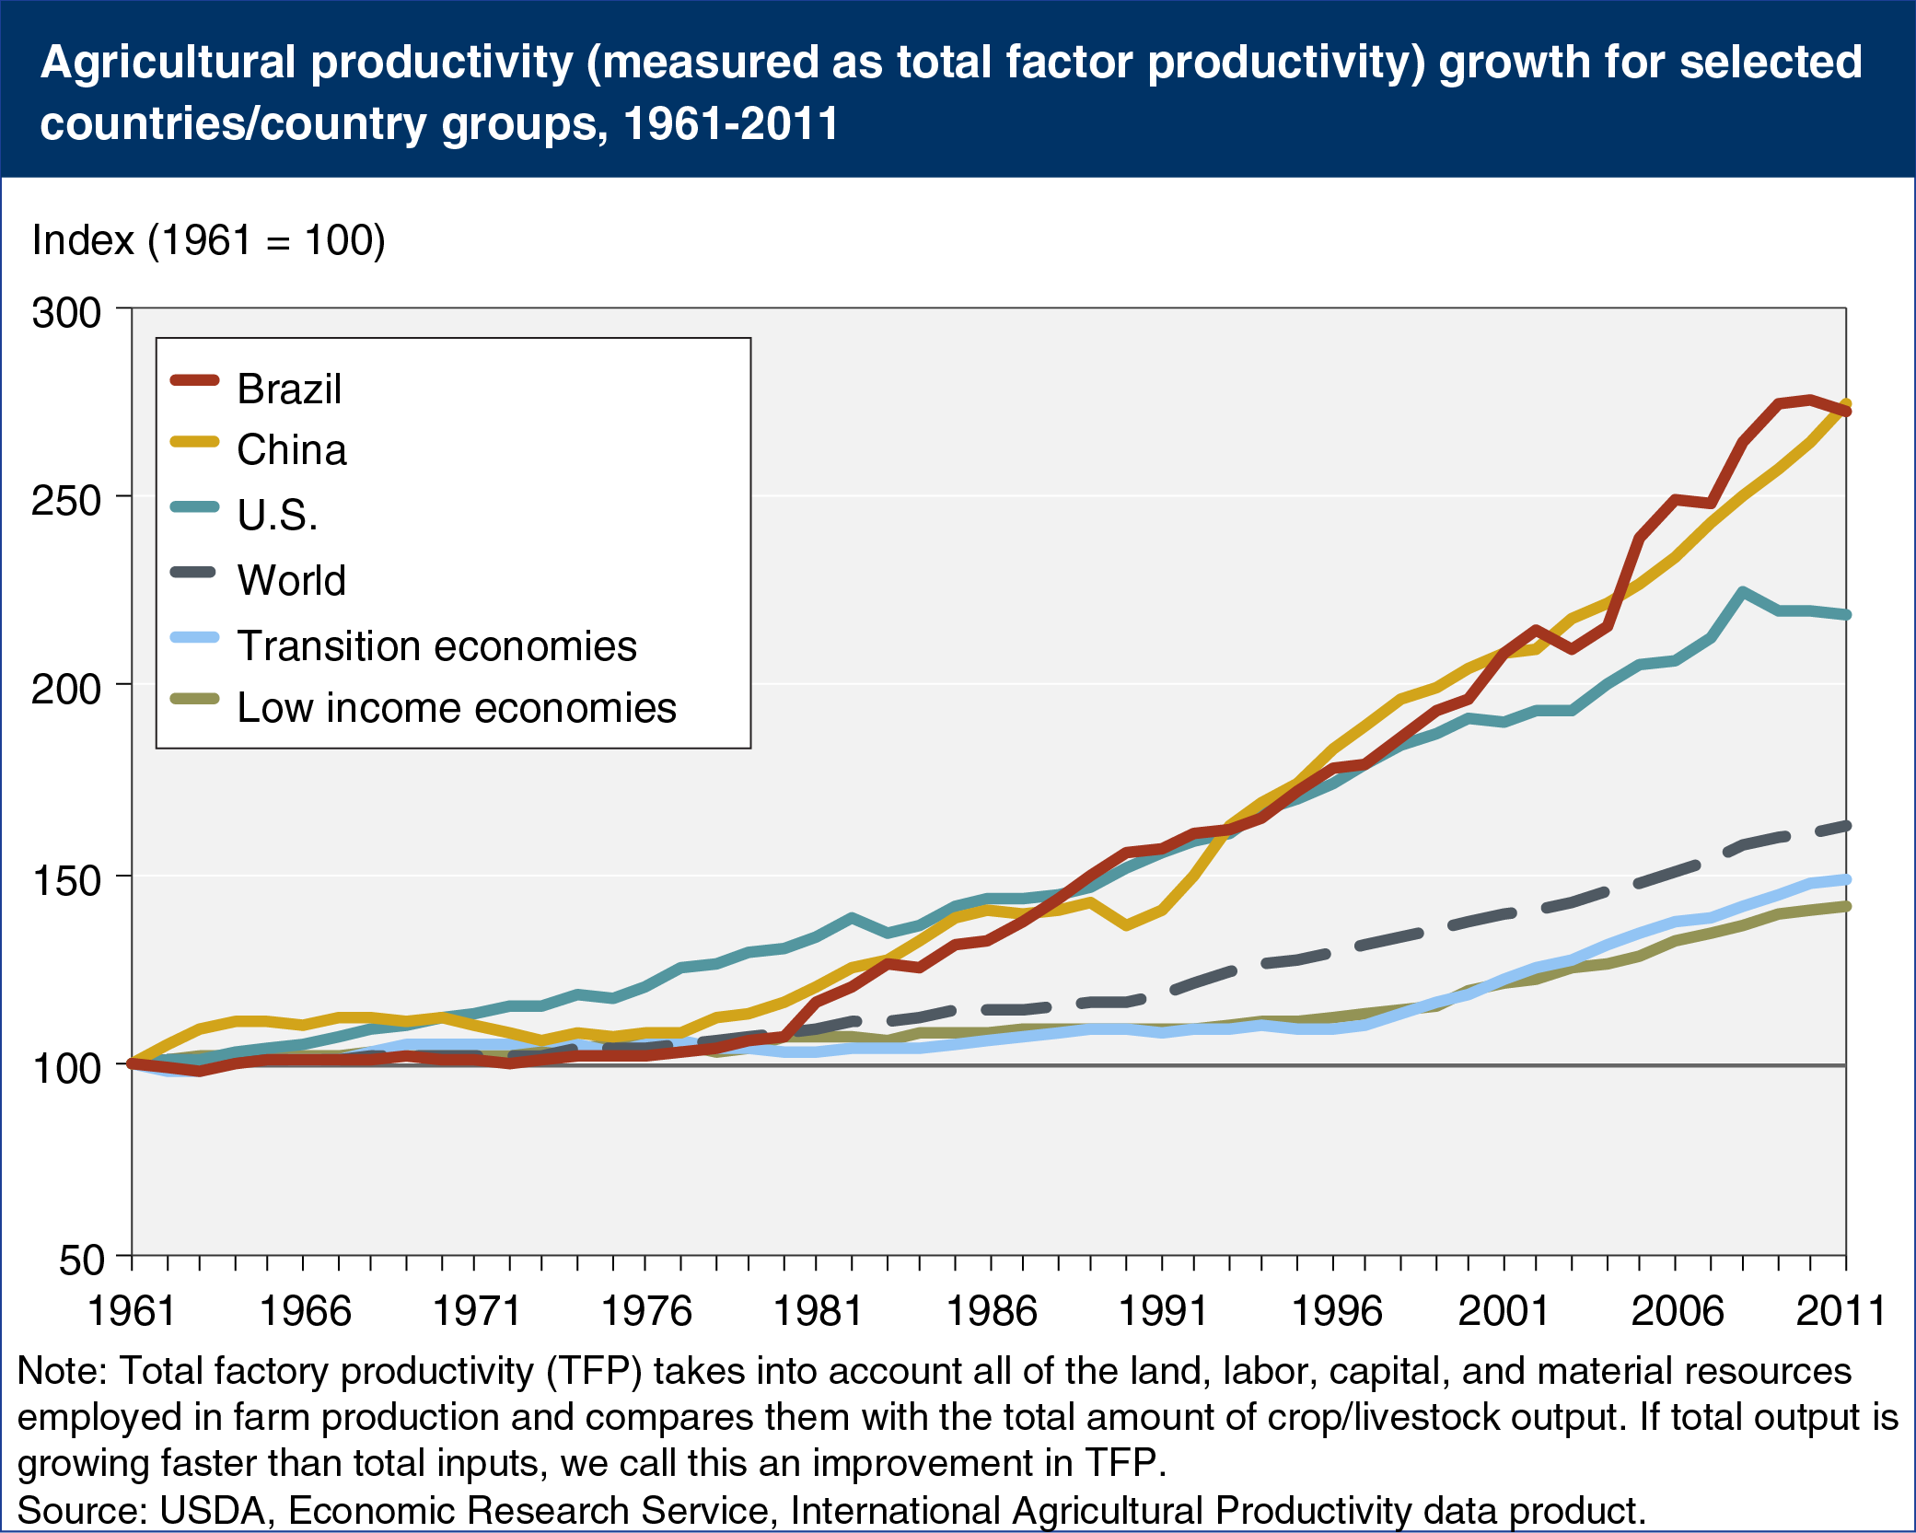
Farm productivity is rising due to;
Better technology and use of machinery (including for ploughing and harvesting).
Increased use of fertilizers & pesticides.
Increasing farm size enables economies of scale.
A growing trend of reducing subsistence farming and increasing commercial farming (through higher yields, faster and lower-cost transport and better political access to foreign markets).

Slide 4
Changing diets (due to growth of middle-income populations)
Globally, diets are homogenising. Wheat, rice, maize, soybean + meat & dairy. Also vegetable oils like palm oil.
Increased calorie, protein, fat & sugar intake.
Homogenising in all countries eg more western food in China, more Chinese food (eg rice & noodles) in the West.

Slide 5
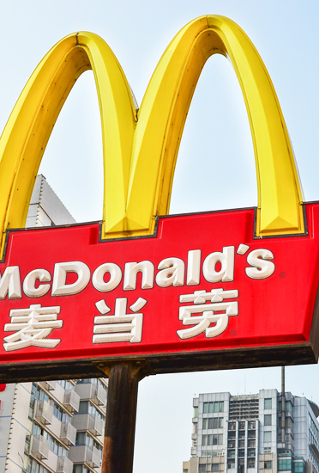
Factors leading to nutritional transition
Rising incomes.
Idea that Western diets are ‘modern’. Fast food consumption becomes aspirational in some markets.
Improvements in transport (faster & lower cost).
More open trade between countries.
Lower food prices due to productivity gains.

Slide 6
Nutrition transition in China
Meat consumption has increased 800% since 1975.
Grain is now sold to feed livestock, leaving less (& higher prices) for human consumption.
2016 - Chinese government plan to reduce meat consumption by 50% to 40-75g per person per day.

