Slide 1
Energy resources

Slide 2
Global energy consumption 1800 - 2000

Slide 3
Global energy consumption per person 1800-1910

Slide 4
Energy consumption by region in 2015

Slide 5
Peak oil

Slide 8
Alternatives to hydrocarbons

Slide 9
Nuclear
First nuclear power station opened in 1954 in USSR.
Currently >450 nuclear power stations around the world.
Accounts for 14% global electricity production.
Biggest source of electricity in France.

Slide 10
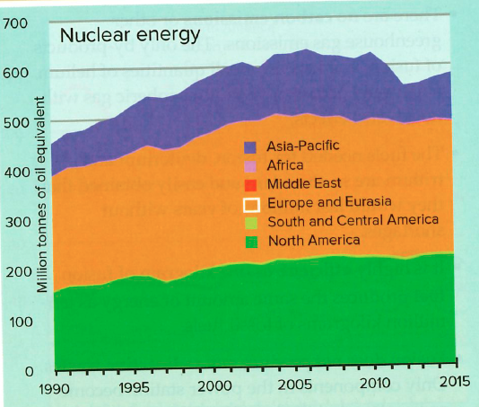

Slide 11
Benefits of nuclear power
Minimal greenhouse gas emissions.
Uranium fuel is relatively low cost and global reserves of 200yrs (Australia, Canada & Kazakhstan major sources).
Can produce power in any weather / climate

Slide 12
Problems of nuclear power
Toxic radioactive waste needs safe disposal/storage.
Nuclear accidents. Three Mile Island (USA 1979), Chernobyl (Ukraine 1986) & Fukushima (Japan 2011).
Expensive to construct. New UK plant will cost at least $50b.
Security risk – Terrorism and theft to make nuclear weapons both possible.

Slide 13
Renewable energy
Hydroelectricity
Wind turbines
Solar
Biofuels
Geothermal
Tidal

Slide 14
Hydroelectricity (HEP)
Major users – New Zealand, Paraguay, Nepal
Requirements:
reliable supply of rain or flowing water.
Relief that allows dam construction.
Financial resources to construct a dam and turbines.

Slide 15
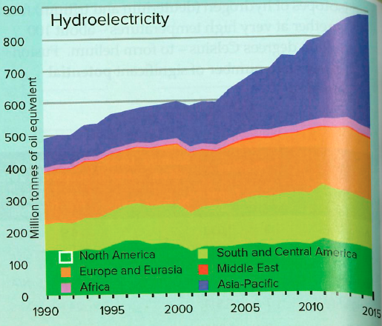

Slide 16
HEP: Environmental impacts
Loss of land - valleys flooded as reservoirs fill.
Forced migration – people move as settlements flood.
Tremors & earthquakes – Weight of water in reservoirs.

Slide 17
HEP Environmental impacts
Silting behind dams – reduces efficiency of power generation.
Loss of sediments down-river – reduces farm productivity
Loss/change of habitats for wildlife.

Slide 18
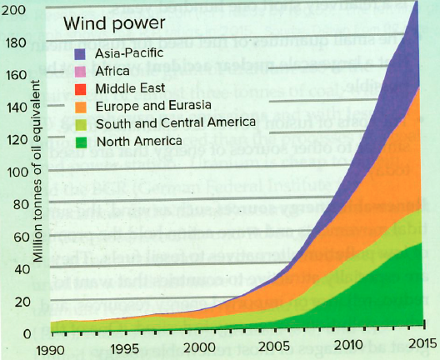
Wind turbines
Requires locations with regular wind (hill-tops or coastal/off-shore).
Can be noisy and spoil areas of natural beauty.

Slide 19
Solar power
Rapidly increasing source of electricity and hot water.
Can be small-scale eg Roofs with photo-voltaic cells to power individual homes.
Growing number of solar power plants.

Slide 20
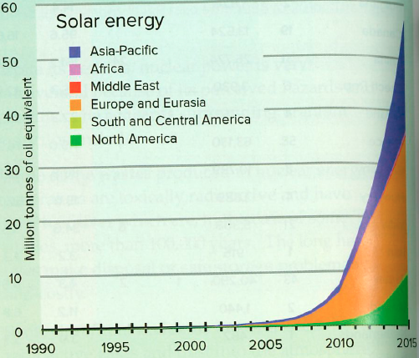

Slide 21
Solar power
Cannot be generated at night, but developments in battery technology mean storage is possible – Tesla in South Australia.

Slide 22
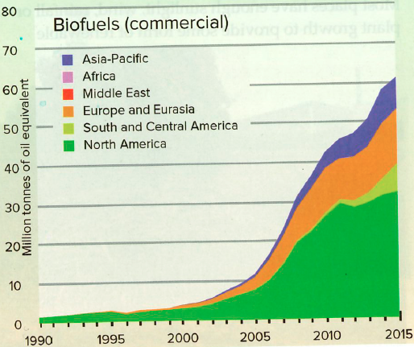
Biofuels
Not including fuelwood (cutting wood to burn), the main sources are:
sugar (to make ethanol)
vegetable oils
biogas (methane from livestock).

Slide 23
Geothermal power
In places that experience volcanic activity (eg Iceland & New Zealand)

Slide 24
Tidal energy
Requires coastline and a large tidal range. eg Swansea, UK, and locations in France and S. Korea.
Benefits – Low running costs and minimal pollution.
Costs - Few possible global locations & expensive to construct. May also interfere with aquatic ecosystems

