Slide 1
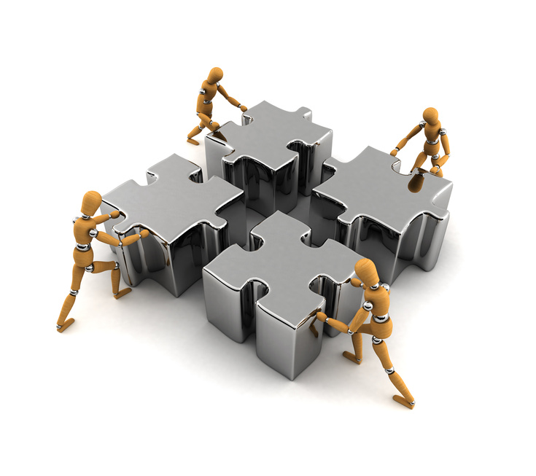
Minimizing our Hypocrisies:
Principles First,
Strategies Second
ACAMIS 2015

Slide 2
Rick Wormeli
703-620-2447
Herndon, VA USA (EST)
@rickwormeli2 (Twitter)
rwormeli@cox.net

Slide 3
“A hypocrite is the kind of politician who would cut down a redwood tree, then mount the stump and make a speech for conservation.”
― Adlai E. Stevenson II
“Hypocrisy: The moment you tell someone it is not important to be right, in order to look right to everyone else.”
― Shannon L. Alder
“I care not for a man's religion whose dog and cat are not the better for it.”
― Abraham Lincoln

Slide 4
“A student is not an interruption of our work…the student is the purpose of it. We are not doing a favor by serving the student…the student is doing us a favor by giving us the opportunity to do so.” -- William W. Purkey from an L.L. Bean Co. poster: “What is a customer?” by J.M. Eaton

Slide 5
‘Forged by the operating tenets with which we perceive the world and conduct our actions.
M
I
N
D
S
E
T
Effective educators regularly assess these principles for validity and revise them in light of new evidence/perspective.
In teaching and leadership, we seek integrity: Our actions reflect our principles. Put another way: We minimize our hypocrisies.

Slide 6
“Four-fifths of my students keep failing their tests! Well, screw ‘em, if they can’t study!”

Slide 7
What Were We Thinking?
Everyone in the same subject in this grade level is on the same page on the same day of the week
Plan accordingly because there is no more paper supply after January
The master schedule cannot be changed to accommodate a compelling guest speaker.
Students cannot re-do final exams.
Sacrifice good pedagogy because people who are untrained are telling you what to do.

Slide 8
What Were We Thinking?
We can’t incorporate a new “app” in our lessons because it promotes the use of personal technology that school hasn’t sanctioned.
Our new students are three grade levels below grade level proficiencies but they have to do well on the final exam anyway.
We can’t take that field trip with the class because that would be too much time away from preparing for the annual state or provincial exam.
“Stop being so creative,” a colleague comments. “You’re making me look bad.”

Slide 9
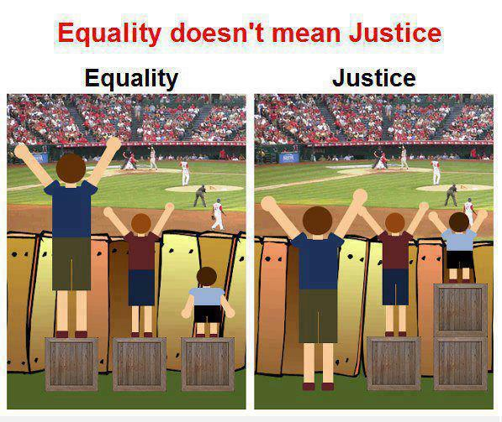
Equal Fair

Slide 10
Sample Teaching/Learning Principles

Slide 11
Oxygen/Nutrient-Filled Bloodflow When the Body is in Survival Mode
Vital Organs
Areas associated with growth
Areas associated with social activity
Cognition

Slide 12
Prime the brain prior to asking students to do any learning experience.
Priming means we show students:
What they will get out of the experience (the objectives)
What they will encounter as they go through the experience (itinerary, structure)

Slide 13
Components of Blood Content Matrix
Red Cells White Cells Plasma Platelets
Purpose
Amount
Size & Shape
Nucleus ?
Where formed
Carries 02 and nutrients
5,000,000 per cc
Small, round,like Cheerios
No
Bone marrow, spleen

Slide 14
The student’s rough draft:
Red blood cells carry oxygen and nutrients around the body. They are small and indented in the middle, like little Cheerios. There are 5 million per cc of blood. There is no nucleus in mature red blood cells. They are formed in the bone marrow and spleen.

Slide 15
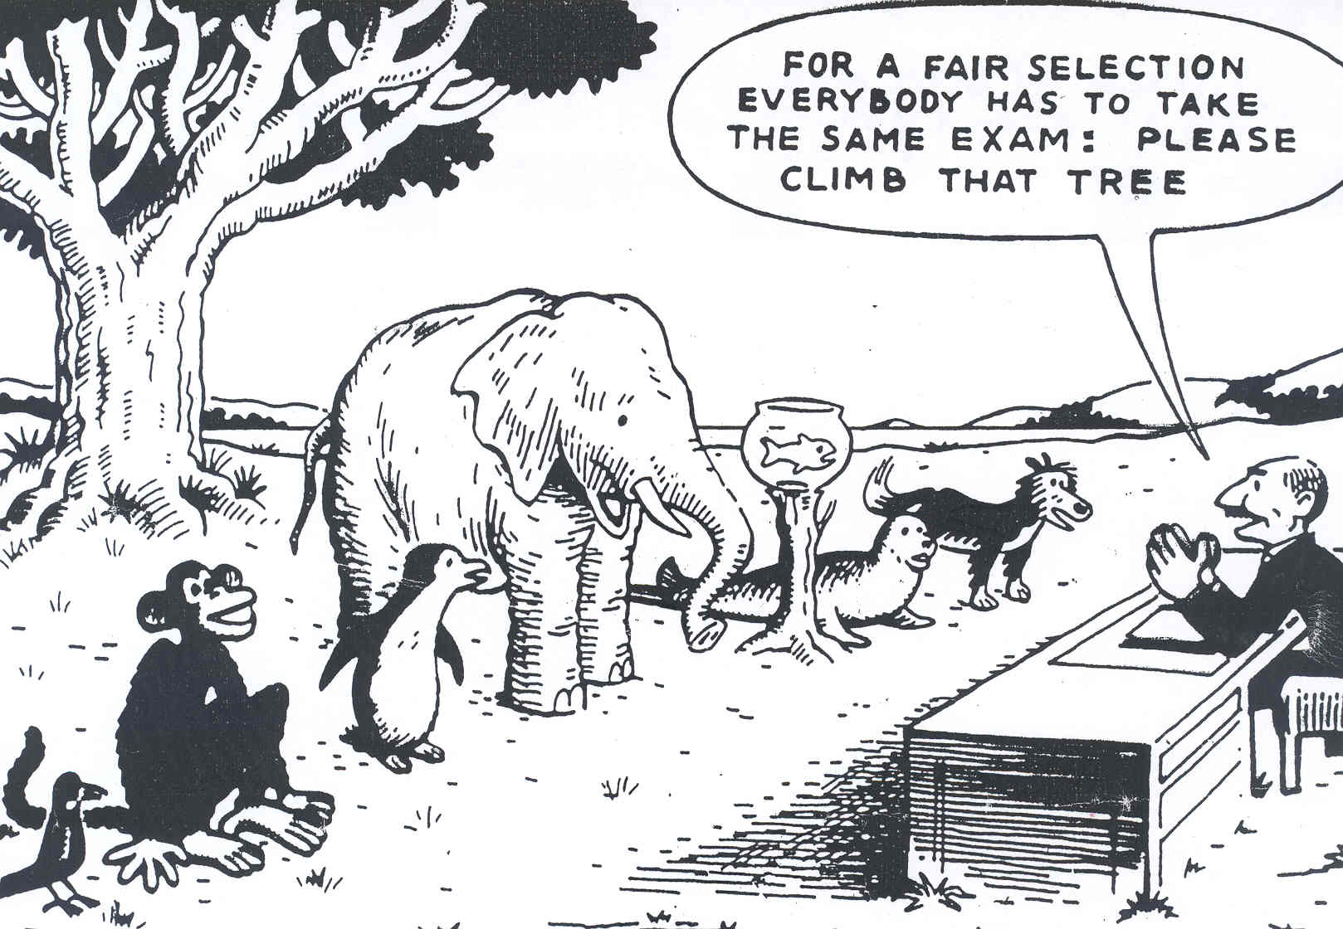
[Artist Unknown
Notes:
Inclusivity involves recognising difference, providing flexibility and choice not uniformity and treating everyone identically.

Slide 16
Recovering in full from a failure teaches more than being labeled for failure ever could teach.
It’s a false assumption that giving a student an “F” or wagging an admonishing finger from afar builds moral fiber, self-discipline, competence, and integrity.

Slide 17
We don’t let a student’s immaturity dictate his learning and thereby his destiny.

Slide 18
F.A.I.L.
First Attempt in Learning

Slide 19
Determining Policies/Actions based on Principles

Slide 20
What do all of these
have in common?
Bernoulli Principle
The Doppler Effect
Refraction
Newton’s Laws

Slide 21
Principle
a fundamental truth or proposition that serves as the foundation for a system of belief or behavior or for a chain of reasoning.
a rule or belief governing one's personal behavior.
morals, morality, (code of) ethics, beliefs, ideals, standards
a general scientific theorem or law that has numerous special applications across a wide field.
a natural law forming the basis for the construction or working of a machine.
-- Chrome search, December 16, 2013

Slide 22
Identify the Principles Involved, THEN Gather the Solutions
Example: How do I grade English Language Learners?
Principles/Tenets Involved:
Teachers must be ethical. They cannot knowingly falsify a score or grade.
To be useful, grades must be accurate reports of evidence of students’ performance against standards.
Regular report cards report against regular, publicly declared standards/outcomes. They cannot report about irregular standards or anything not publicly declared.
Any test format that does not create an accurate report of students’ degree of evidence of standards must be changed so that it does or replaced by one that does.
(continued)

Slide 23
Identify the Principles Involved, THEN Gather the Solutions
Example: How do I grade English Language Learners?
Principles Involved: (Continued)
English Language Learners have a right to be assessed accurately.
Lack of language proficiency does not mean lack of content proficiency.
Effective teachers are mindful of cultural and experiential bias in assessments and try to minimize their impact.
If teachers act upon these principles,
what decisions/behaviors/policies should we see
in their assessment and grading procedures?

Slide 24
Personal Principles
of Pedagogy
What are your top 5 non-negotiable
principles of teaching/learning?

Slide 25
For each principle, identify evidence of it in your practices or policies.
If there is no evidence, why not?
If there is evidence, how do you know it works?

Slide 26
In your small groups, ask for critique:
Declare a principle/policy and its evidence of use.
The group reflects with you whether or not the evidence truly represents the principle.
If the evidence is inadequate, the group must decide what evidence of policy and practice would best manifest the principle.

Slide 27
To identify some of these principles, reflect on the bigger questions:
How does my approach reflect what we know about students this age?
Why do we grade students?
Does our current approaches best serve students?
How do we communicate with parents?
How does assessment inform our practice?
Is what we’re doing fair and developmentally appropriate?
How can we counter the negative impact of poverty/mobility/issues on our students’ learning?
What role does practice play in mastery?
What is mastery for each curriculum we teach?
What is homework, and how much should it count in the overall grade?
How are our current structures limiting us?

Slide 28
Whose voice is not heard in our deliberations?
What do we know about differentiated practices and the latest in cognitive theory and how are those aspects manifest in our classrooms? If not, why not?
Are we mired in complacency?
Are we doing things just to perpetuate what has always been done?
Are we open to others’ points of view – why or why not?
Does our report card express what we’re doing in the classroom?
How are modern classrooms different from classrooms thirty years ago?
Where will our practices look like 15 years from now?
To what extent do we allow state, provincial, country, or international exams to influence our classroom practices?

Slide 29
Principles create moral imperative.

Slide 30
What goes unachieved in students because we chose to be politically safe?

Slide 31
In addition to students’ learning, should a teacher be evaluated by her principles, by the degree to which her actions match her principles, or should neither of these be considered?

Slide 32
Principles:
What Do They Mean
for Policy and Practice?
Directions:
Choose the principles for which you have strong opinions first.
For each one: What does full support of this principle mean for you? Look at both policies and practices, including those you do not currently have in place as well as those you do. Brainstorm here – let your imagination really explore ramifications.

Slide 33
Professionalism
Principles

Slide 34
Teachers are responsible for
their own professional development.

Slide 35
“The nature of relationships among the adults within a school has a greater influence on the character and quality of that school and on student accomplishment than anything else.”
- Roland S. Barth

Slide 36
Just because we can’t fathom the logistics doesn’t mean we abandon the principle.

Slide 37
“We can’t be creative unless we’re willing to be confused.”
– Margaret Wheatley

Slide 38
I will not sacrifice effective pedagogy
because people without training
in teaching are setting policy.

Slide 39
We can’t drive forward by looking in the rearview mirror.
(“Rearview-Mirror Effect,” White, 2011)

Slide 40
Everyone needs to save face, be honored.

Slide 41
At any given moment,
every person is usually doing the best they can.

Slide 42
Our future depends on the individuals
who break from conventional practices.

Slide 43
How
Students
Best
Learn
Principles

Slide 44
Chance favors the prepared mind. (Pasteur)

Slide 45
What students learn is influenced by their existing ideas.

Slide 46
When connections form knowledge structures that are accurately and meaningfully organized, students are better able to retrieve and apply their knowledge effectively and efficiently. In contrast, when knowledge is connected in inaccurate or random ways, students can fail to retrieve or apply it appropriately.
(Carnegie Melon)

Slide 47
Memorization is still important in a,
“You can always look it up” world.

Slide 48
Personal processing, meaning-making after initial learning,
has more impact than my presentation of content to students.

Slide 49
“Learning is fundamentally an act of creation,
not consumption of information.”
(Sharon L. Bowman, Professional Trainer)

Slide 50
“Collaboration increases learning;
isolation and competition decrease it.”
(Sharon L. Bowman, Professional Trainer)

Slide 51
“Emotion drives attention, attention drives learning.”
-- Robert Sylwester, 1995, p. 119, Wolfe

Slide 52
Students learn at different rates of speed.

Slide 53
Strict, unwavering adherence to pacing mandates,
regardless of student need, is willful act of failure.

Slide 54
We should teach in the ways students best learn,
not the way we best learn.

Slide 55
Progression in learning is usually
from the concrete to the abstract.

Slide 56
“All thinking begins with wonder.”
-- Socrates

Slide 57
The brain is innately social.

Slide 58
Changing standards alone will not
improve student achievement.

Slide 59
We can’t get creative students from non-creative classrooms.

Slide 60
Teacher are no longer the only oracle
or final arbiter of knowledge.

Slide 61
My testimony as a teacher is what students
carry forward at the end of my lessons,
not what I presented to them during those lessons.

Slide 62
Whoever does the editing does the learning.

Slide 63
“Carrots and sticks” motivation systems
don’t work for cognitive learning and growth.

Slide 64
Students’ motivation determines, directs,
and sustains what they do to learn.
(Carnegie Melon)

Slide 65
Homework is practice of what has already been learned,
not for learning content for the very first time.

Slide 66
Assess/Grading
Principles

Slide 67
When instructing and grading,
I am criterion-referenced, not norm-referenced.

Slide 68
The important question is not, “What is the standard?” The most important question is, “What evidence of the standard will we tolerate as indicators of mastery?”

Slide 69
Grades are communication,
not compensation.

Slide 70
Anything that diffuses the accuracy of a grade
is removed from our grading practice.
We cannot conflate reports of compliance
with evidence of mastery.

Slide 71
Just because something is mathematically easy to calculate
doesn’t mean it’s pedagogically correct.

Slide 72
Averaging scores distorts the accuracy
of grades reported for any one individual.

Slide 73
Assessment accuracy increases
with sample size and multiple assessments.

Slide 74
Being good at taking standardized tests doesn’t
qualify students for creative contribution to society.

Slide 75
Removing students from p.e., fine and performing arts classes in order to double up on reading and math classes for standardized test success actually does more harm than good.

Slide 76
Recovering in full from failure
teaches more than being labeled for failure can teach.
We should not let a student’s lack of developmnt
dictate his learning, and thereby, his destiny.

Slide 77
Fair isn’t always equal,
and I will always be fair.

Slide 78
Formative, descriptive feedback is critical to a student’s success, but such feedback loses it’s instructional impact when the formative task is judged or evaluated.

Slide 79
Parroting is not mastery.
Skillful, intellectual agility is.
I teach for mastery.

Slide 80
If students can articulate the learning goal and their position in relation to it, they can achieve it significantly more often.

Slide 81
Scenarios/
Hypotheticals

Slide 82
A
Two students struggle with graphing the intersection of two inequalities, so the teacher asks them to graph only one instead.
A student gets 100% on a pre-test, so the teacher asks the student to do a personal research topic related to the general subject of the unit for the duration of their studies.

Slide 83
B
All students in Mr. Brown’s class keep journals in math. The type of journal matches each student’s strengths and interests. For example, one journal is for the students whose verbal skills are stronger than their math skills. Students keep a list of math terms learned in class and then use the terms in sentences. Another journal is for students have good visual-spatial skills. These students draw pictures to remind them of math vocabulary.

Slide 84
C
Upon receiving his paper and reading the poor grade recorded at the top, a student looks the teacher in the eye and says loud enough for the class to hear: “You bitch!”
The teacher raises or lowers what she expects of students regarding the grade level curriculum based on their developmental level, and she adjusts her assignments for them accordingly.

Slide 85
D
In the same 30 minutes, advanced students get 25 math problems while struggling students are assigned only five.
A student who seems to mix up decimal places and place values in his math problems is asked to do his work on graph paper, even on tests, thereby keeping his numbers clearly within their columns.

Slide 86
E
The student didn’t use his time wisely on this week’s project. As a result, he submits a very poor version of what he can normally achieve, and it receives a low grade. The teacher lets the student re-do the project over the next few days, however, and he does it well. The teacher then attributes full credit to the student for having mastered the relevant standards.
The teacher gives students a list of 50 methods to represent their learning for the final project and asks them to choose any two of them to complete.

Slide 87
F
Six students are identified as gifted/advanced in a particular subject, so the teacher spreads them throughout her student work groups so they can help those who struggle. She reasons that they will help the low performers, and they’ll learn the material better themselves for having taught it to others.
In preparation for a class discussion of how reptiles and amphibians regulate internal body temperature, the science teacher asks a student known for his interest in auto mechanics to explain how most car engines regulate internal temperature. Other students are asked to explain how we regulate the temperature of our homes and buildings as well as our own bodies.

Slide 88
G
Eleven students do not do the assignment from last night.
Consequently, they are not prepared to move on with the
class in today’s task.
There are only enough microscopes for every three students.
One student in each group uses the microscope to bring items
into focus, another draws what the group sees through the
eyepiece, then all three students answer the comprehension
questions.

Slide 89
Processing Activity:
“I used to
think…,
but now
I think…”

