Slide 1
The Personal Project
How am I assesseD?

Slide 2
Criterion A
Investigating
i. define a clear goal and global context for the project, based on personal interests!
ii. identify prior learning and subject-specific knowledge relevant to the project !
iii. demonstrate research skills !

Slide 3
i. define a clear goal and global context for the project, based on personal interests!

Slide 4
i. define a clear goal and global context for the project, based on personal interests!
through the one Global Context
and personal interest
Notes:
justify how and why this Context is most
appropriate for your project and provides the perspective through which
your project is undertaken.

Slide 5
Create a durable bag using second
hand materials
Create a range of bags using second
hand materials to exhibit at the local
arts center
Notes:
Highly Challenging Goal
Page 19

Slide 6
ii. identify prior learning and subject-specific knowledge relevant to the project !

Slide 7
ii. identify prior learning and subject-specific knowledge relevant to the project !
Connect to subject-specific knowledge
And prior knowledge

Slide 8
iii. demonstrate research skills !
Notes:
Your research must be recorded in your process journal. As you develop your product, you should continue to create new questions and conduct research.
In order to demonstrate "excellent research skills
record in your process journal and report on
the OPVL

Slide 9
OPVL
Notes:
Your research must be recorded in your process journal. As you develop your product, you should continue to create new questions and conduct research.
In order to demonstrate "excellent research skills
record in your process journal and report on
the OPVL

Slide 10
Origin: Addresses the who, what, where and when of a given source.
Notes:
Your research must be recorded in your process journal. As you develop your product, you should continue to create new questions and conduct research.
In order to demonstrate "excellent research skills
record in your process journal and report on
the OPVL

Slide 11
• Purpose: Addresses the "why" of a source. Why did the author create this source? What was his/her intent when he/she created this piece?
What is the bias of the piece?
Notes:
Your research must be recorded in your process journal. As you develop your product, you should continue to create new questions and conduct research.
In order to demonstrate "excellent research skills
record in your process journal and report on
the OPVL

Slide 12
• Value: How does this source help me achieve my goal? Is the author/ publisher credible? How is this relevant to achieving my goal?
Notes:
Your research must be recorded in your process journal. As you develop your product, you should continue to create new questions and conduct research.
In order to demonstrate "excellent research skills
record in your process journal and report on
the OPVL

Slide 13
• Limitation: Is the source current? Is the source accurate? Is the information in the source supported by evidence? Is the source objective or subjective?
Notes:
Your research must be recorded in your process journal. As you develop your product, you should continue to create new questions and conduct research.
In order to demonstrate "excellent research skills
record in your process journal and report on
the OPVL

Slide 14
Criterion A: Investigating
define a clear and highly challenging goal and context for the project, based on personal interests; identify prior learning and subject-specific knowledge that is consistently highly relevant to the project; and demonstrate excellent research skills.
7 - 8

Slide 15
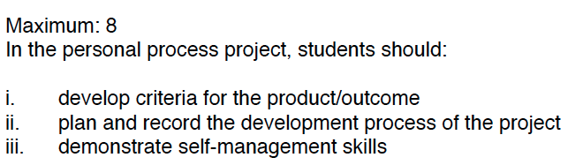
Criteria B - Planning

Slide 16
Criteria B – 7-8 band

Slide 17
Criteria B – Strand i
With the help of your supervisor and an expert, determine the factors which make your product successful, and of a high-quality.
Also determine how you will test your product to see if it meets these specifications

Slide 18
Criteria B – Strand i
ACCESS FM
Aesthetics
Cost
CUSTOMER
Environment
Safety
Size
FUNCTION
Materials

Slide 19
Criteria B – Strand ii
Your plan needs to define not only the starting and ending points of your process, but describe the significant steps in between.
You need to record your plan, as well as how you applied your research and information to your plan, in your process journal.
Your plan will be assessed in the Planning Criterion, so it is essential you include a plan.

Slide 20
Criteria B – Strand ii
Things to consider when developing your plan and to include in the process journal:
What resources do I need to develop my product?
What major steps do I need to take to complete my product?
What is the timeframe for completing each step of my product?
Is my plan logical and feasible?
Which research did I use to create my plan and why?
Does my plan allow me to meet my evaluation criteria?
How does this plan allow me to develop my understanding of my Global Context?

Slide 21
Criteria B – Strand ii
Step | Process | Resources | Time | Safety/Quality | Changes to plan.
E.g. 1 | Collect plywood for the base | - | 5 mins | Be careful handling ply as edges can give splinters
2 | Mark out base on ply | Pencil, ruler, tri square | 10 mins | Mark accurately and recheck measurements
Notes:
Criteria B – Strand ii

Slide 22
Criteria B – Strand iii
Demonstrate excellent self management skills
What is meant by self management?
How can YOU demonstrate it?

Slide 23
Criterion C
Taking Action
i. create a product/outcome in response to the goal, global context and criteria !
ii. demonstrate thinking skills !
iii. demonstrate communication and social skills!

Slide 24
i. create a product/outcome in response to the goal, global context and criteria !

Slide 25
i. create a product/outcome in response to the goal, global context and criteria !
The product/outcome

Slide 26
ii. demonstrate thinking skills !

Slide 27
ii. demonstrate thinking skills !
As you create, you need to think about the application of your information, make connections to your Global Context and reflect on the successes and obstacles of your creation process.

Slide 28
ii. demonstrate thinking skills !
Demonstrating application of your researched information,and reflection on the process of creation is an integral part of the personal project.

Slide 29
• Which research was applied, and how was it applied to your product?
• What decisions were made based on which resources?
• What were the solutions to problems you encountered, and how did you develop each solution?

Slide 30
• What were the results of trial and error, and how did you use this information in the development of your product?
• How did the research and development of your product fit your chosen
Global Context?

Slide 31
As you develop your product, it is vital you regularly record your ideas, challenges and solutions in your process journal. This information will be needed to demonstrate thinking, communication and social skills.

Slide 32
iii. demonstrate communication and social skills!

Slide 33
It is through your report that you communicate your information, reflection, thinking, and transfer skills.

Slide 34
• Outline your report and have it checked by your supervisor.
Write it in chunks by focusing on one section of the report at a time. Then, have your supervisor edit each chunk before you move on.
Notes:
This will allow you to receive feedback and advice
before you tackle the entire report.

Slide 35
Criterion C: Taking Action
create an excellent product/outcome in response to the goal,
global context and criteria; demonstrate excellent thinking skills;
and demonstrate excellent communication and social skills.
7 - 8

Slide 36
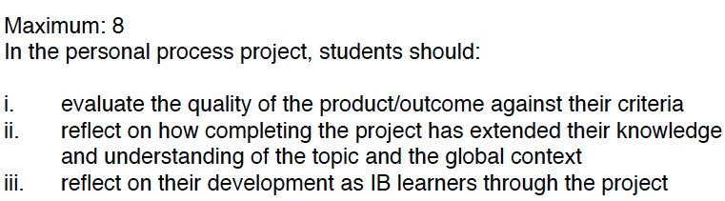
Criteria D - Reflecting

Slide 37
Criteria D – 7-8 band

Slide 38
Criteria D – Strand i
Test your product against your Success Criteria, maybe use a testing table to show your findings
Success criteria | Test | Outcome
Suitable for 3-8yr olds | User trial and survey of PYP teachers | From my testing I found that my product....
Specification continued

Slide 39
Criteria D – Strand i
Summarise the testing outcomes evaluting the success of the products performance .
Highlight were the product performed well.
Highlight areas were the product was lacking.
Give recommendations for future improvements in the process and the product.

Slide 40
Criteria D – Strand ii
What have you learnt about the topic while doing your PPP?
What have you learnt about the Global Context?

Slide 41
Criteria D – Strand iii
What is an IB learner?
How have you improved in any of these aspects?

